Slide 1

Database Management System (DBMS)
(Course code: 21CS2110RA)
CO# 1 ,Session# 6:
Session Topic: Relational Database Design using ER Diagrams

Slide 2
Session Objective
Students should be able to understand
Relational Database Design using ER Diagrams

Slide 3
Outline
ER-to-Relational Mapping Algorithm
Step 1: Mapping of Regular Entity Types
Step 2: Mapping of Weak Entity Types
Step 3: Mapping of Binary 1:1 Relation Types
Step 4: Mapping of Binary 1:N Relationship Types.
Step 5: Mapping of Binary M:N Relationship Types.
Step 6: Mapping of Multivalued attributes.
Step 7: Mapping of N-ary Relationship Types.
Mapping EER Model Constructs to Relations
Step 8: Options for Mapping Specialization or Generalization.
Step 9: Mapping of Union Types (Categories).

Slide 4
Relational Database
Design by ER- and EER-to-Relational Mapping
Design a relational database schema
  Based on a conceptual schema design
Seven-step algorithm to convert the basic ER model constructs into relations
Additional steps for EER model

Slide 5
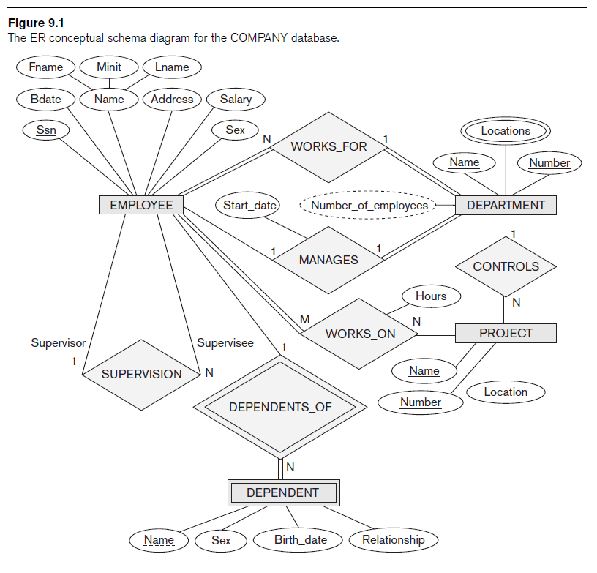
Relational Database Design Using ER-to-Relational Mapping

Slide 6
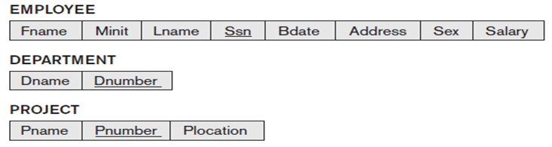
ER-to-Relational Mapping Algorithm
Step 1: Mapping of Regular Entity Types
  For each regular (strong) entity type E in the ER schema, create a relation R that includes all the simple attributes of E.
  Choose one of the key attributes of E as the primary key for R. If the chosen key of E is composite, the set of simple attributes that form it will together form the primary key of R.

Slide 7

ER-to-Relational Mapping Algorithm (cont’d.)
Step 2: Mapping of Weak Entity Types
  For each weak entity type W in the ER schema with owner entity type E, create a relation R and include all simple attributes (or simple components of composite attributes) of W as attributes of R.
  In addition, include as foreign key attributes of R the primary key attribute(s) of the relation(s) that correspond to the owner entity type(s).
  The primary key of R is the combination of the primary key(s) of the owner(s) and the partial key of the weak entity type W, if any.
Essn references Ssn EMPLOYEE

Slide 8

ER-to-Relational Mapping Algorithm (cont’d.)
Step 3: Mapping of Binary 1:1 Relation Types
For each binary 1:1 relationship type R in the ER schema, identify the
relations S and T that correspond to the entity types participating in R. There
are three possible approaches:
(1) Foreign Key approach: Choose one of the relations-S, say-and include a foreign key in S the primary key of
T. It is better to choose an entity type with total participation in R in the role of S.
(2) Merged relation option: An alternate mapping of a 1:1 relationship type is possible by merging
the two entity types and the relationship into a single relation. This may be appropriate when both participations are total.
(3) Cross-reference or relationship relation option: The third alternative is to set up a third relation R for the
purpose of cross-referencing the primary keys of the two relations S and T representing the entity types.
Mgr_ssn references SSN of EMPLOYEE

Slide 9
Binary 1:1
Employee
1
1
CHAIR
Sits_on
Case 2: Uniform participation types
The primary key of either of the participants can become a foreign key in the other

Slide 10
Binary 1 : 1
Employee Table
EmpCode PK
EmpName
DateofJoining
SkillSet
Chair
ItemNo PK
Model
Location
Used_By FK
OR
Employee Table
EmpCode PK
EmpName
DateofJoining
SkillSet
Sits_On FK
Chair
ItemNo PK
Model
Location

Slide 11

ER-to-Relational Mapping Algorithm (cont’d.)
Step 4: Mapping of Binary 1:N Relationship Types
  For each regular binary 1:N relationship type R, identify the relation S that represent the participating entity type at the N-side of the relationship type.
  Include as foreign key in S the primary key of the relation T that represents the other entity type participating in R.
  Include any simple attributes of the 1:N relation type as attributes of S.
WORKS_FOR relationship
Dno references Dnumber of DEPARTMENT
Dnum References Dnumber of DEPARTMENT
Super_SSN References Ssn of EMPLOYEE
CONTROLS relationship
SUPERVISION relationship

Slide 12

ER-to-Relational Mapping Algorithm (cont’d.)
Step 5: Mapping of Binary M:N Relationship Types
  For each regular binary M:N relationship type R, create a new relation S to represent R.
  Include as foreign key attributes in S the primary keys of the relations that represent the participating entity types; their combination will form the primary key of S.
  Also include any simple attributes of the M:N relationship type (or simple components of composite attributes) as attributes of S.
Relational attribute
Essn References Ssn of EMPLOYEE
Pno References Pnumber of PROJECT
Primary Key

Slide 13

ER-to-Relational Mapping Algorithm (cont’d.)
Step 6: Mapping of Multivalued attributes
  For each multivalued attribute A, create a new relation R. This relation R will include an attribute corresponding to A, plus the primary key attribute K-as a foreign key in R-of the relation that represents the entity type of relationship type that has A as an attribute.
  The primary key of R is the combination of A and K. If the multivalued attribute is composite, we include its simple components.
Dnum References Dnumber DEPARTMENTS
Primary Key

Slide 14
ER-to-Relational Mapping Algorithm (cont’d.)
Step 7: Mapping of N-ary Relationship Types
  For each n-ary relationship type R, where n>2, create a new relationship S to represent R.
  Include as foreign key attributes in S the primary keys of the relations that represent the participating entity types.
  Also include any simple attributes of the n-ary relationship type (or simple components of composite attributes) as attributes of S.

Slide 15
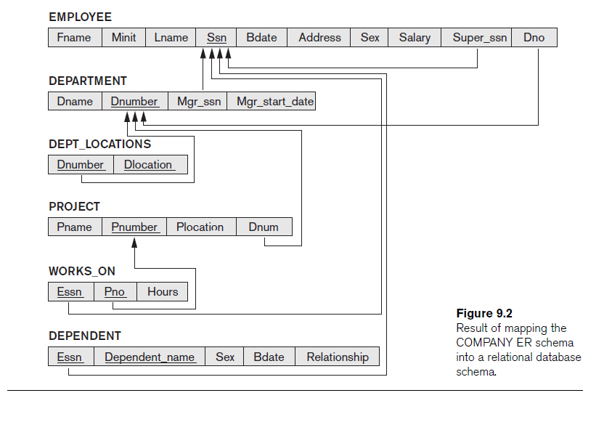
Relational Schema Diagram

Slide 16
Mapping EER Model Constructs to Relations
Step8: Options for Mapping Specialization or Generalization.
Convert each specialization with m subclasses {S₁, S₂,….,S_{m}} and generalized superclass C, where the attributes of C are {k,a₁,…a_{n}} and k is the (primary) key, into relational schemas using one of the four following options:
Option 8A: Multiple relations-Superclass and subclasses.
Create a relation L for C with attributes Attrs(L) = {k,a₁,…a_{n}} and PK(L) = k.
Create a relation L_{i} for each subclass S_{i}, 1 < i < m, with the attributesAttrs(L_{i}) = {k} U {attributes of S_{i}} and PK(L_{i})=k.
This option works for any specialization (total or partial, disjoint of over-lapping).
Option 8B: Multiple relations-Subclass relations only
Create a relation L_{i} for each subclass S_{i}, 1 < i < m, with the attributes Attr(L_{i}) = {attributes of S_{i}} U {k,a₁…,a_{n}} and PK(L_{i}) = k.
This option only works for a specialization whose subclasses are total (every entity in the superclass must belong to (at least) one of the subclasses).

Slide 17
Mapping of Specialization or Generalization
Step8: Options for Mapping Specialization or Generalization
Option 8C: Single relation with one type attribute.
Create a single relation L with attributes Attrs(L) = {k,a₁,…a_{n}} U {attributes of S₁} U…U {attributes of S_{m}} U {t} and PK(L) = k.
The attribute t is called a type (or discriminating) attribute that indicates the subclass to which each tuple belongs
Option 8D: Single relation with multiple type attributes.
Create a single relation schema L with attributes Attrs(L) = {k,a₁,…a_{n}} U {attributes of S₁} U…U {attributes of S_{m}} U {t₁, t₂,…,t_{m}} and PK(L) = k. Each t_{i}, 1 < I < m, is a Boolean type attribute indicating whether a tuple belongs to the subclass S_{i}.

Slide 18


Option 8 a)
Converting Specialization

Slide 19
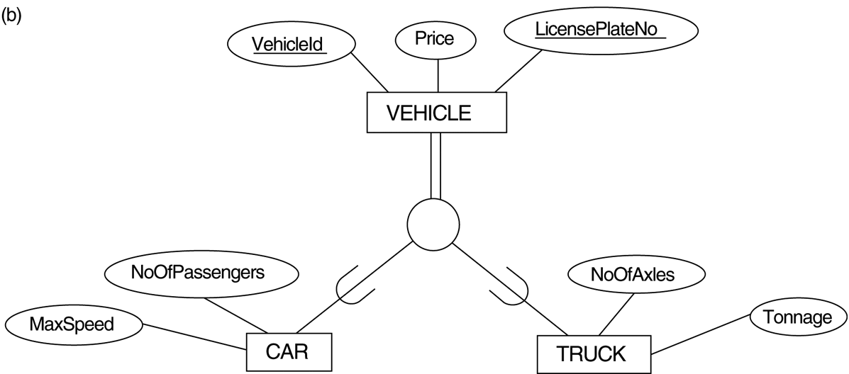

Option 8 b)
Converting Generalization

Slide 20
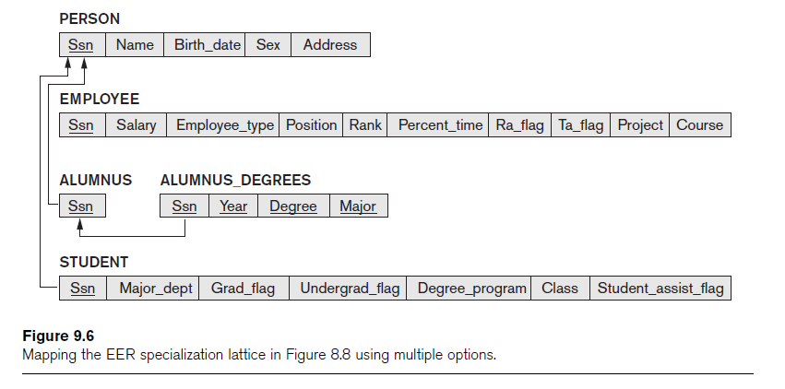
Mapping of Shared Subclasses (Multiple Inheritance)
Apply any of the options discussed in step 8 to a shared subclass

Slide 21
Option 8 c)
Mapping specialization
or
Generalization
with one option

Slide 22

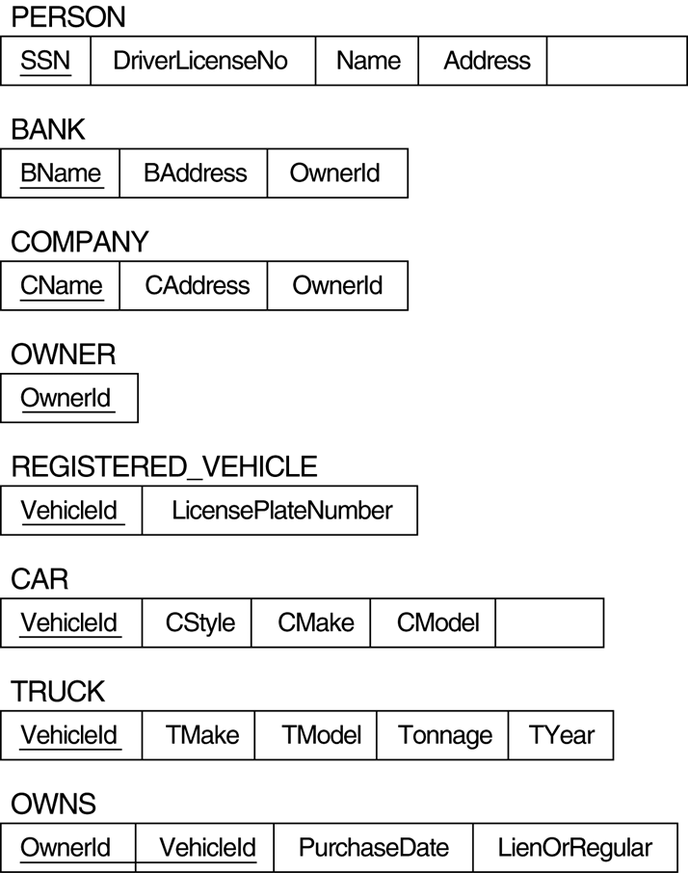
Step 9 : Mapping of Union Categories

Slide 23
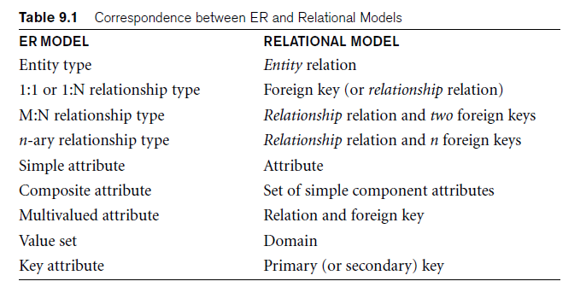
Discussion and Summary of Mapping for ER Model Constructs

Slide 24
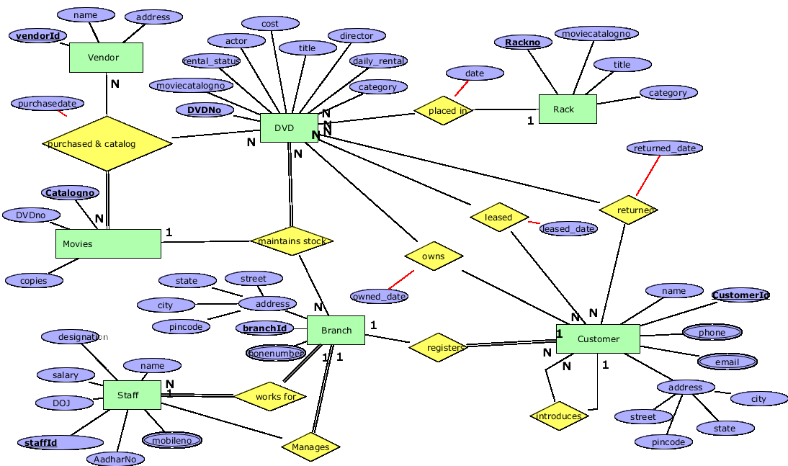

Slide 25
Example:
Step-1: Mapping of Regular Entity Types With Simple attributes
Tables | Attributes
STAFF | Staffid, Staffname,Doj,Designation,Salary,Aadharno
BRANCH | BranchID, Street,City,Pincode,State
VENDOR | VendorID, Vendorname,Address
MOVIE_MASTER_CATALOGUE | Catalogno, Copies,Title,Category
CUSTOMER | CustomerID, Fname,lname,Street,City,Pincode
DVD | DvdNo, Moviecatalogno,Dailyrental,Actor,Director,Title,Cost, Category
RACK | Rackno, Location,Title,Category
© 2016 KL University – The contents of this presentation are an intellectual and copyrighted property of KL University. ALL RIGHTS RESERVED

Slide 26
Step-2:
No Weak Entities in MVRO
Foreign Key References Staffid of STAFF
Step-3 : Mapping of Binary 1:1 Relation Types
Tables | Attributes
BRANCH | BranchID, Street,City,Pincode,State ,Staffid
Foreign Key References CustomerID of CUSTOMER
Foreign Key References Rackno of CUSTOMER
Step-4: Mapping of Binary 1:N Relationship Types
Tables | Attributes
DVD | Dvdno, Moviecatalogno,Dailyrental, Actor,Director,Title,Cost,Category,CustomerID, Owneddate, Placed_date, Rackno
CUSTOMEFR | CustomerID, Fname,Lname,Street,City,Pincode,Registereddate,BranchID
STAFF | Staffid, Staffname, Doj,Designation,Salary,Aadharno,BranchID
Foreign Key References BranchID of BRANCH

Slide 27
Step-5 : Mapping of Binary M:N Relationship Types
Foreign Key References Dvdno of DVD
Tables (new) | Attributes
DVD_LEASED | Dvdno, CustomerID, Leaseddate
DVD_RETURNS | Dvdno, CustomerID, Returndate
Foreign Key References CustomerId of CUSTOMER
Step-6: Mapping of Multivalued attributes
Tables (new) | Attributes
STAFF_MOBILE | Staffid, Mobile
BRANCH_PHONE | BranchID, Phone
CUSTOMER_MOBILE | CustomerID, Mobile
CUSTOMER_MAIL | CustomerID, Email
Foreign Key References Staffid of STAFF
Step-7 : Step 7: Mapping of N-ary Relationship Types
Tables (new) | Attributes
PURCHASE_CATALOG | Catalogno, VendorID, Dvdno
STOCK | Catalogno, BranchID, Dvdno

Slide 28
Tables | Attributes
VENDOR | VendorID, Vendorname,Address
MASTER_MOVIE_CATALOG | Catalogno, Copies,Title,Category
RACK | Rackno, Location,Title,Category
BRANCH | BranchID, Street,City,Pincode,State ,Mgrid
DVD | Dvdno, Moviecatalogno,Dailyrental,Actor,Director,Title,Cost,Category, CustomerID, Owneddate, Placed_date, Rackno
CUSTOMER | CustomerID, Fname,Lname,Street,City,Pincode,Registereddate,BranchID
STAFF | Staffid, Staffname, Doj,Designation,Salary,Aadharno, BranchID
DVD_LEASED | Dvdno, CustomerID, Leaseddate
DVD_RETURNS | Dvdno, CustomerID, Returndate
STAFF_MOBILE | Staffid, Mobile
BRANCH_PHONE | BranchID, Phone
CUSTOMER_MOBILE | CustomerID, Mobile
CUSTOMER_EMAIL | CustomerID, Email
PURCHASE_CATALOGUE | Catalogno, VendorID, Dvdno
STOCK | Catalogno, BranchID, Dvdno

